Slide 1
24-25 Course Selection for Incoming 9th Grade Families
Peters Township High School
Class of 2028

Slide 2
The PTHS Counseling Team
Ms. Patton
A-C
PattonA@pt-sd.org
x8907
Mrs. Wolf
D-Hh
WolfC@pt-sd.org
x8910
Ms. Simmons
Hi-Mh
SimmonsA@pt-sd.org
x8909
Mrs. Prinsen
Mi-Se
PrinsenH@pt-sd.org
x8908
Mr. Sudol
Sf-Z
SudolJ@pt-sd.org
x8906
Mrs. Clifford
CliffordD@pt-sd.org
Mrs. Fecher
FecherM@pt-sd.org
Mrs. Steffen
Steffenl@pt-sd.org

Slide 3
The PTHS Principals
Dr. Pavlik
High School Building Principal
PavlikL@pt-sd.org
Mr. Wilson
Assistant Principal
Last Names: A-L
WilsonG@pt-sd.org
Mrs. Conroy
Assistant Principal
Last Names M-Z
ConroyJ@pt-sd.org
Administrative Secretaries
Ms. Valley
Secretary
ValleyS@pt-sd.org
Mrs. McLaughlin
Secretary
McLaughlinS@pt-sd.org

Slide 4
The PTHS Counseling Team
The PTHS Counseling Program provides a developmental counseling program addressing college and career readiness, personal/social, and academic needs for all students.
Visit us online at: https://www.ptsd.k12.pa.us/hsCounseling.aspx

Slide 5
Academic Integrity at PTHS
Honest and responsible scholarship. Students respect their own learning as well as that of others by submitting their own original work, citing sources, identifying work completed collaboratively, and maintaining honesty during assessments.
Student Honor Code: “As a student of Peters Township School District, I recognize the value of my own learning and pledge to maintain honesty and academic integrity in all that I do. All work that I submit is my own.”

Slide 6
College & Career Readiness:
Counseling Curriculum
Starting your journey in 9th grade:
Introduction to Naviance
Career Exploration
Career Interest Surveys
SMART Goal Setting
PSAT 8/9
Time Management
Study Skills
Organization Skills
Getting Involved

Slide 7
PTHS Graduation Requirements:
CLASS OF 2028
4
ENGLISH
0.50
PERSONAL WELLNESS
4
SOCIAL STUDIES
0.50
PHYSICAL EDUCATION
4
MATHEMATICS
0.50
TECHNOLOGY
4
SCIENCE
7.5
ELECTIVES
1
Total Credits: 26
ARTS/HUMANITIES

Slide 8
Keystone Exams
Students will take the following Keystone Exams:
Algebra I
Biology
Literature
Each exam will be taken upon completion of the related course:
Algebra I (8th or 9th grade)
Biology (8th or 9th grade)
Literature (10th grade)

Slide 9
The Course Description Book (CDB) is an invaluable resource to assist each student in taking the courses that best meet their academic goals and further exploration of career interests. Students should use the CDB to research the expected curricular topics, workload, and description of the courses they are choosing.

Slide 10
Understanding Course Levels
01
Academic Level
03
College in High School (CHS) Level
A college and career preparatory class. Students should expect regular homework assignments in these classes. Homework is designed to reinforce and extend concepts learned in class.
A college-level class offered through our school’s partnership with a local university. Students may earn college credits upon successful completion of the course.
02
Honors Level
04
Advanced Placement (AP) Level
A rigorous college and career preparatory course which demands a high level of critical thinking and above-average analytical reading skills. The pacing of the course requires students to work outside of the classroom.
A first-year college level course that follows the College Board’s Syllabus and prepares students for the Advanced Placement Exams offered in May each year. Students that sign-up for an Advanced Placement class are encouraged to take the Advanced Placement Exam in the course(s) that they complete.

Slide 11
Dual Enrollment Opportunities
for 11th & 12th Grade
Pre-Apprenticeship Program with the German American Chamber of Commerce
CCBC High School Academies
Programs:
Aviation
Criminal Justice
Education
Health Science
Programs:
Mechatronics Technician
Sales Engineering
Polymer Process Technician
CAD/CAM Technical Designer

Slide 12
Western Area Career &
Technology Center
Auto Mechanics
Automation Robotics Engineering Technology
Carpentry
Collision Repair Technology
Cosmetology
Culinary Arts & Baking
Electrical Occupations
Emergency Protective Services
Rehabilitative Aide/Sports Medicine
Health Assistant
Heating, Air, & Ventilation (HVAC)
Machine Shop
Masonry
Networking
Welding

Slide 13
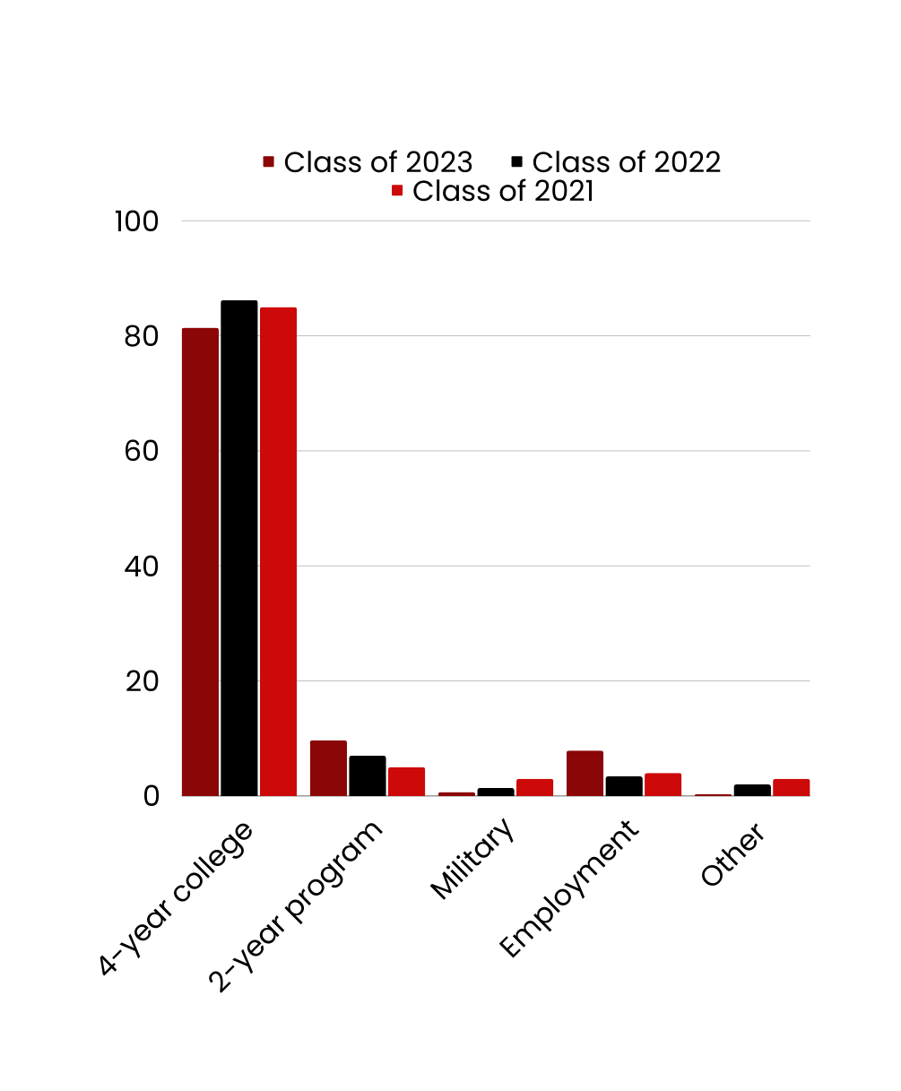
Postsecondary Options
2-Year College
4-Year College
Military
Trade/
Technical College
Employment

Slide 14
High School Transcript
Transcript of Student Accepted to University of Pittsburgh, Penn State, or Duquesne University
Tota
Cumulative
GPA: 4.15
Cumulative
Unweighted
GPA: 3.84

Slide 15
High School Transcript
Transcript of Student Accepted into a US News Top 25 College
Cumulative
GPA: 5.56
Cumulative
Unweighted
GPA: 4.0
Additional Factors: Community
Involvement, Character Traits, Passion/Drive

Slide 16
Course Selection
by Subject
Peters Township High School

Slide 17
9th Grade English
Select One
9
English 9 Academic
8
Language Arts 8
9
English 9 Honors
*Summer Reading
Required

Slide 18
9th Grade Mathematics
Select One
9
Algebra I Academic
8
Math 8 or Algebra Fundamentals
9
Algebra I Foundations
Math placement is based on
results of Keystone Exams.
*Teacher Recommendation
9
Geometry Academic
8
Algebra I
9
Geometry Honors
9
Algebra II Academic
8
Geometry Honors
9
Algebra II Honors

Slide 19
9th Grade Science
Select One
9
Biology Academic
8
Science 8
9
Biology Honors
9
Chemistry Academic
8
Biology Honors
*6 periods Per Week (LAB)
9
Chemistry Honors
*7 Periods Per Week (LAB)

Slide 20
9th Grade Social Studies
Select One
9
Global Studies Academic
8
Social Studies 8
9
Global Studies Honors

Slide 21
3 World Language Courses
French
Spanish
German
Recommendations:
Two levels/year in high school of the same World Language will meet most four-year college admission requirements.
World Language is strongly encouraged for students planning to attend a four-year postsecondary program.

Slide 22
9th Grade World Language
Select One
9
French I
8
French, German, Spanish, A, B, or Reading 8
9
German I
9
Spanish IB or Spanish I
*Requires completion of Spanish A
9
French II
*Requires completion of French B
8
French, German, or Spanish B
9
German II
*Requires completion of German B
9
Spanish II
*Requires completion of Spanish B

Slide 23
9th Grade Physical Education
Select Both
9
Physical Education
8
Physical Education
Health
*(PE I, II)
9
Personal Wellness

Slide 24
9th Grade Technology Credit
Select at least one
9
AP Computer Science
Principles
*Completion of Algebra I
9
Introduction to STEM
8
Computer Applications
Technology Education
9
Technology Applications
9
Media I: Mass Communication

Slide 25
9th Grade Elective Offerings
Arts/Communications & Media Career Pathways
Theatre Arts I and II
Piano/Song Writing Lab
Art I and Art II
Music Theory
Mixed Choir
Media I: Mass Communication
Concert Band
Media Editing
Orchestra

Slide 26
9th Grade Elective Offerings
Business, Engineering, & Technology Career Pathways
AP Computer Science Principles (YR)
Intro to STEM
Technology Applications
Agile Robotics I & II
Web Page Design
Architectural Engineering (YR)
Gaming Programming
Automation Engineering
CHS Computer Programming JAVA
Competitive Technology (YR)
Business 101
Computer Aided Drafting & Design

Slide 27
Course Scheduling Considerations
Will I be overloaded with honors courses, electives, & extracurriculars?
What do college and universities look for?
How many Honors/AP courses should I take?
Should I schedule a semester or full-year study hall?

Slide 28
Sample 9th Grade Schedules
Peters Township High School

Slide 29
PERIOD | First Semester (Aug-Jan) | Second Semester (Jan-June)
1 | English 9 Honors | English 9 Honors
2 | Global Studies Academic | Global Studies Academic
3 | Geometry Academic | Geometry Academic
4 | Biology Academic | Biology Academic
5 | Lunch | Personal Wellness (Health Graduation Requirement)
6 | Media I: Mass Communication | Lunch
7 | Spanish II | Spanish II
8 | Concert Band (YR Elective) | Concert Band
9 | PE I, II (Graduation Requirement) | World Mythology (Elective)

Slide 30
PERIOD | First Semester (Aug-Jan) | Second Semester (Jan-June)
1 | English 9 Honors | English 9 Honors
2 | PE I, II (Graduation Requirement) | Personal Wellness (Health Graduation Requirement)
3 | Algebra II Honors | Algebra II Honors
4 | Media I: Mass Communication | Business 101 (Elective)
5 | Global Studies Honors | Global Studies Honors
6 | Lunch | Lunch
7 | German II | German II
8 | Chemistry Honors (5 Days per Week) | Chemistry Honors (5 days per week)
9 | Chemistry Lab (2 days per week) Study Hall (3 days per week) | Chemistry Lab (2 days per week) Study Hall (3 days per week)

Slide 31
Powerschool Course Selection
Select ‘Class Registration’

Slide 32
Powerschool Course Selection
Scheduling My Courses

Slide 33
Finalizing Course Requests
Submission
Student must request a minimum of 6.25 credits and cannot exceed 8.0 credits (this does not include alternative elective selections).
Print
Return the printout to your Social Studies teacher by March 14, 2024
New to the district - submit course selection sheet by March 14, 2024 (email, mail, or in-person).
Changes
If you would like to change a request after hitting submit, changes can be completed up until the portal closes.
Contact the HS Counseling Office or the 8th grade counselor, Mrs. Wawrzeniak, with questions.

Slide 34
Powerschool Course Selection
Print & Submit your Course Requests to your Social Studies teacher by March 14, 2024
New to the district - submit to via email, mail, or in-person to the Counseling office.
Parent Signature

Slide 35
Tips for Success
Develop Study Habits: Mix up your study methods & review material regularly to solidify the material.
Stay Organized: Manage time to reduce stress, boost organization, and responsibility. Plan activities out into manageable tasks.
Be mindful: Forgive your mistakes, acknowledge your effort, and celebrate your small victories. View any setbacks as an opportunity to learn and grow
Ask for Help: Reach out to your teachers to ask questions, clarify questions, & advocate for yourself.

Slide 36
Get Involved!
There are many different activities and clubs offered at the high school. Getting involved in these clubs is one more way for students to explore interests and meet people. Check out the high school website for more details!

Slide 37
Move-Up Day:
March 1st, 2024
Freshmen Orientation:
August 12,2024

